Slide 1
MODULE V
Enterprise JavaBeans

Slide 2
Overview
The Enterprise JavaBeans (EJB) specification is an industry initiative lead and driven by Sun Microsystems
The term Enterprise implies that the application will be scalable, available, reliable, secure, transactional, and distributed

Slide 3
Overview ...
Part of the J2EE specification
Contains the application’s business logic and live business data
Provides distributed, object-oriented and component based architecture.

Slide 4
Overview ...
In order to provide these types of features, an Enterprise application requires access to a variety of infrastructure services
Distributed communication services
Naming and directory services
Transaction services
Messaging services,
Data access and persistence services
Resource-sharing services

Slide 5
Overview ...
These infrastructure services are often implemented on different platforms using a variety of products and technologies
Building portable enterprise-class application systems can be very difficult.
The J2EE APIs provide a common interface that supply easy access to these underlying infrastructure services

Slide 6
Architecture
Client
Web Server
Container
EJB Server
App Server(DB)

Slide 7
Benefits of EJB
Reusable application components :
component reuse and outsourcing,
declarative customization
ability for the developer to focus on business logic only.
Portability :
can be run on any vendor’s application server.
Broad industry adoption:
Wider selection of vendor tools and components

Slide 8
Benefits of EJB ...
Application portability
Code is more than just platform independent; it is also middleware independent.
No vendor lock-in
Architecture decisions are made at deployment, not at development
Protection of IT investment
Wraps and integrates with the existing infrastructure, application, and data stores;

Slide 9
Distributed Programming
Client makes a call to what appears to be the interface of a business object.
What it actually calls is a stub that mimics the interface of that business object.
This layer between clients and business objects is added because it is more practical to place stubs in the remote and distributed locations of clients than it is to place complete copies in the location of business objects.

Slide 10
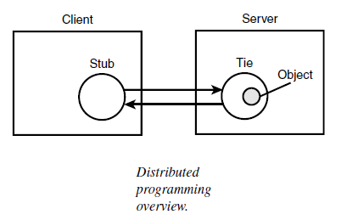
Distributed Programming ...
Marshalling
Commn Channel
Un marshalling

Slide 11
Distributed Programming ...
In a distributed framework, the client calls a business method on a stub as if it were the real object.
The stub then communicates this request to a tie. The tie calls the method on the real business object.
The result is returned to the stub and the client
A stub is also known as a proxy or a surrogate, and a tie is also known as a skeleton.

Slide 12
EJB Framework
Benefits
EJB components are server-side components written entirely with the Java programming language; therefore, applications based on EJB components are not only platform independent but also middleware independent
EJB components contain business logic only, giving developers freedom from maintaining system-level code that would be integrated with their business logic.

Slide 13
EJB Framework ...
EJB architecture is transactional, distributed, portable, multitier, scalable, and secure.
Components are declaratively customized: Customizable traits include transactional behaviour, security features, life cycle, state management, and persistence.

Slide 14
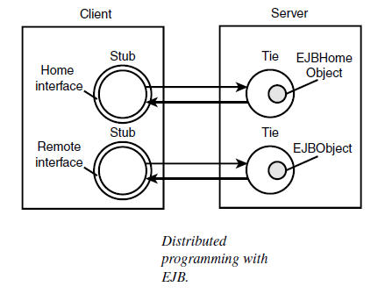
Distributed Programming with EJB

Slide 15
Containers
The application server provides a container that supports services for components.
A container is an entity that provides life cycle management, security, deployment, and runtime services to components.
Each container type (including EJB, Web, JSP, Servlet, Applet, and Application Client) provides component-specific services as well.

Slide 16
EJB Container
Bean life cycle management and instance pooling :
These services include creation, activation, passivity, and destruction.
State management :
Individual EJBs do not need to explicitly save or restore the conversational object state between method calls.
Bean transaction management :
The EJB container can automatically manage the start, the enrollment, the commitment, and the rollback of transactions on behalf of the EJB.

Slide 17
EJB Container ...
Security constraint enforcement
The EJB container automatically performs all security checking on behalf of the EJB.
Distributed remote access:
Uses Remote Method Invocation (RMI)
Internet InterORB Protocol (IIOP).
Container-managed persistence (CMP)
EJBs do not need to explicitly retrieve or store persistent object data from a database.
The EJB container can automatically manage persistent data on behalf of the EJB.

Slide 18
EJB Container ...
Generated remote stubs
The container will create remote stubs for wrappers such as RMI and CORBA
Additional Functionality
provides an environment that supports the execution of applications developed using EJB architecture,
managing and coordinating allocation of resources to the applications.

Slide 19
EJB Container ...
responsible for registering the object
providing a Remote interface for the object
creating and destroying object instances
checking security for the object
managing the active state for the object
coordinating distributed transactions.

Slide 20
Container Location
Any number of EJB classes can be installed in a single EJB container.
A particular class of EJB is assigned to one and only one EJB container
a container may not necessarily represent a physical location.
it could be implemented as a logical entity that can be replicated and distributed across any number of systems and processes.

Slide 21
Types of EJB
Message driven beans
Entity beans
Session beans

Slide 22
Assignment II Date :15/11/19
Explain the exception handling in JSP;
Using JSTL Tags for Error Page
Using Try...Catch Block
With a neat diagram explain the lifecycle of EJB
Explain CORBA with a diagram
Explain RMI with a diagram
Transaction management
Security deployment

Slide 23
Session and Entity Beans
The EJB specification supports both transient and persistent objects. A transient object is referred to as a session bean, and a persistent object is known as an entity bean.

Slide 24
Message Driven Bean
Useful for passing messages to one server to another server

Slide 25
Session bean
Useful for maintain sessions
A session bean is an EJB that is created by a client and usually exists only for the duration of a single client-server session
A session bean usually performs operations such as calculations or database access on behalf of the client
it is not recoverable if a system crash occurs.

Slide 26
Entity beans
An entity bean is an object representation of persistent data maintained in a permanent data store such as a database.
Entity beans represent specific data or collections of data, such as a row in a relational database.
An entity bean can be created in two ways:
by direct action of the client in which a create method is called on the bean’s Home interface
by some other action that adds data to the database that the bean type represents.

Slide 27
Entity beans ...
An entity bean can implement either bean-managed or container-managed persistence.
In the case of bean-managed persistence, the implementer of an entity bean stores and retrieves the information managed by the bean through direct database calls.
The bean may utilize either JDBC or SQLJ for this method.
A disadvantage to this approach is that it makes it harder to adapt bean-managed persistence to alternate data sources.

Slide 28
Entity beans ...
In the case of container-managed persistence, the container provider may implement access to the database using standard APIs.
The container provider can offer tools to map instance variables of an entity bean to calls to an underlying database.
This approach makes it easier to use Entity Beans with different databases.

Slide 29
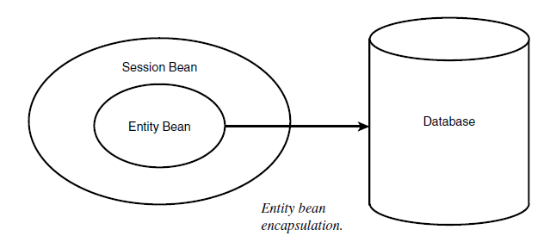
Encapsulating Entity Beans with Session Beans

Slide 30
Encapsulating Entity Beans with Session Beans ...
Encapsulating an entity bean inside a session bean is usually a good design choice for several reasons:
It will prevent a remote client from starting a transaction.
It will eliminate direct exposure of the entity beans to remote clients.
It allows entity beans to be more reusable

Slide 31
Attributes of a Bean
There are two choices that can be made for a “state” attribute of a bean.
Beans can either be stateful or stateless.
With stateful beans, the EJB container saves internal bean data during and in between method calls on the client’s behalf
With stateless beans, the clients may call any available instance of an instantiated bean for as long as the EJB container has the ability to pool stateless beans.

Slide 32
Stateless Beans
A session bean represents work performed by a single client
That work can be performed within a single method invocation, or it may span across multiple method invocations.
If the work spans multiple methods, the object must maintain the user’s object state between method calls.
The state management options for session beans are defined in the StateManagementType attribute in the DeploymentDescriptor object.

Slide 33
Stateless Beans ...
Stateless beans are intended to perform individual operations automatically and don’t maintain state across method invocations.
They’re also amorphous, in that any client can use any instance of a stateless bean at any time at the container’s discretion.

Slide 34
Stateful Beans
Stateful session beans maintain state both within and between transactions.
Each stateful session bean is associated with a specific client.
Containers are able to save and retrieve a bean’s state automatically while managing instance pools of stateful session beans.

Slide 35
Stateful Beans ...
Stateful session beans maintain data consistency by updating their fields each time a transaction is committed.
To keep informed of changes in transaction status, a stateful session bean implements the SessionSynchronization interface.
The container calls methods of this interface while it initiates and completes transactions involving the bean.

Slide 36
Parts of a Bean
EJBHome Object :
object that provides the life cycle operations (create, remove,find) for an EJB
The container’s deployment tools generate the class for the EJBHome object.
Home Interface:
The EJBHome object implements the EJB’s Home interface
provides access to the bean’s life cycle services and can be utilized by a client to create or destroy bean instances.

Slide 37
Parts of a Bean ...
EJBObject Interface:
The EJBObject interface provides access to the business methods within the EJB.
EJBObject:
EJBObject represents a client view of the EJB.
The EJBObject exposes all of the application related interfaces for the object, but not the interfaces that allow the EJB container to manage and control the object.

Slide 38
Parts of a Bean ...
Deployment Descriptor:
The deployment descriptor is an XML file provided with each module and application that describes how the parts of a J2EE application should be deployed.
The deployment descriptor configures specific container options in your deployment tool of choice.
The rules associated with the EJB governing life cycle, transactions, security, and persistence are defined in an associated XML deployment descriptor object

Slide 39
SessionContext and EntityContext Objects
For each active EJB instance, the EJB container generates an instance context object to maintain information about the management rules and the current state of the instance.
A session bean uses a SessionContext object, while an entity bean uses an EntityContext object.

Slide 40
Container-Managed Persistence (CMP) and Bean-Managed Persistence (BMP)
There are two ways that bean persistence can be managed.
The first method is to let the container manage the persistence of the bean. This method is called container managed persistence (CMP).
The second method for managing persistence is called bean-managed persistence (BMP).
This method requires that the developer implement the interaction code between the EJB and the persistence engine.

Slide 41
Bean-Managed Persistence
This is a complex and intricate task.
Thus, this mode must not be seen as a general development model, but more as a means to implement a low-level persistence mechanism if necessary
When using bean-managed persistence (BMP), it is the bean that is responsible for storing and retrieving its persisted data.
In BMP mode, the EJB must implement persistence. To do this, methods such as ejbStore and ejbLoad must be created and used, and communication with SQL databases must be implemented manually using JDBC.

Slide 42
Container-Managed Persistence (CMP)
In container-managed persistence, entity bean data is maintained automatically by the container that uses the mechanism of its choosing.
For example, a container implemented on top of a Relational Database Management System (RDBMS) may manage persistence by storing each bean’s data as a row in a table.

Slide 43
Persistence Manager
A persistence manager is used to separate the management of bean relationships from the container
With this separation, a container has the responsibility for managing security, transactions, and so on, while the persistence manager is able to manage different databases via different containers.
Using this architecture allows entity beans to become more portable across EJB vendors.

Slide 44
Persistence Manager ...
Entity beans are mapped to the database using a bean-persistence manager contract called the abstract persistence schema. The persistence manager is responsible for implementing and executing find methods based on Enterprise JavaBeans Query Language (EJB QL).

Slide 45
The Contract
A contract between the CMP entity bean and persistence manager allows for defining complex and portable bean-to-bean, bean-to-dependent, and even dependent-to dependent object relationships within an entity bean.
In order for the persistence manager to be separated from the container, a contract between the bean and the persistence manager is defined.

